Slide 1
FSM 1 : Intro to Finite State Machines
©Copyright CHUA DINGJUAN. All rights reserved.

Slide 2
What is a FSM?
FSM : Finite State Machine
Synchronous Machine with “states” of operation
At each active clock edge, combinational logic computes outputs and next state, as a function of inputs and present state
Examples ?
Inputs
Combinational Logic
Outputs
n
n
Present
State
Q D
Flip-Flops
Next
State
CLK

Slide 3
Mealy and Moore
Moore vs Mealy FSMs : Different Output Generation
Mealy machine: output is a function of a present state & inputs.
Output Logic
Next State
Current State
Inputs
Next State Logic
State Memory
(FFs)
Outputs
CLK
Moore machine: output is a function of a present state only.
Next State
Current State
Inputs
Next State Logic
State Memory
(FFs)
Output Logic
Outputs
CLK

Slide 4
Structure
State Memory
set of n FFs store current state of machine; up to 2^{n} states.
FFs can be J-K or D, but D FFs simpler (1 input vs. 2 inputs for J-K FFs)
Next State Logic
combinational circuit which decides the next state of the machine based on current state and inputs:
Next state = f (inputs, current state)
Output logic
combinational circuit which creates the output Moore : outputs depend on current state
outputs = g (current state)
Mealy : outputs depend on the current state & inputs
outputs = g (inputs, current state)

Slide 5

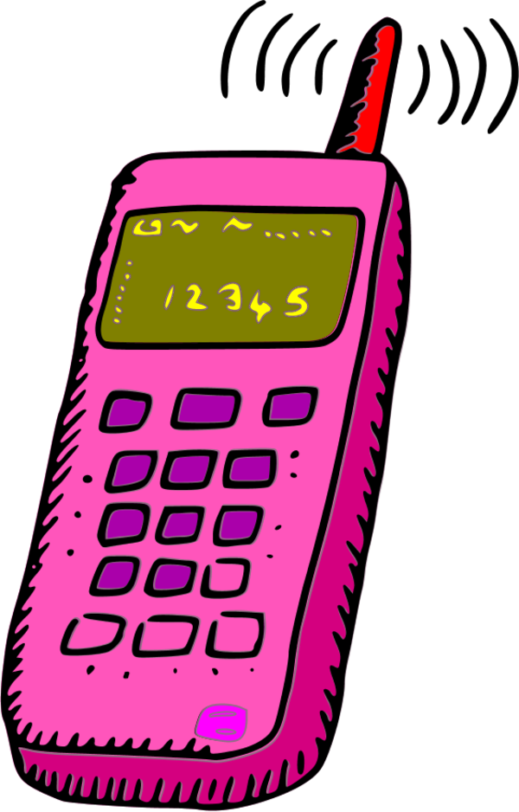

Traffic Problem…

At a busy intersection on campus…
Students from the Law faculty are burying their heads in their books and are not looking where they are going.
Students from the Business faculty are occupied on their phones and aren’t looking at where they’re going either….
Law Avenue
Business Street

Slide 6
Traffic Problem…
1) Sensors T_{B} and T_{L} is TRUE when students are present. False otherwise.
2) Control traffic lights L_{L}, L_{B} to be green, yellow, red.
3) Reset to Green on Law Ave and Red on Business St.
Design a FSM to control the traffic lights!
T_{B}
L_{B}
T_{L}
T_{L}
L_{L}
L_{L}
Law Avenue
L_{B}
T_{B}
Every 5 sec, check the traffic and decide what to do!
If the lights on Business St. are green and there’s no traffic, the lights turn yellow for 5 secs. After that, they turn red and Law Ave. lights turn green.
So on, so forth.
If there is traffic, lights do not change.
Business Street

Slide 7
Step 1 : State Transition Diagram
Overall Block Diagram of System
Design State Transition Diagram to represent FSM
CLK
S0
L_{L}: green
L_{B} : red

Slide 8
State Transition Diagrams
“At clock edge, if T_{L}=1, stay in State 0.”
Arbitrary state names.
RST
T_{L} = 1
Start at this state upon reset.
S0
L_{L}: green
L_{B} : red
T_{L} = 0
S1
L_{L}: yellow
L_{B} : red
Desired outputs in current state.
(Moore / Mealy)?
Desired outputs in current state.
“At clock edge, If T_{L}=0, go to State 1.”
Circles represent states. * Each state specifies values for all outputs (Moore)
Arcs represents transitions between states. * Labels ➔ input that triggers the transition. * Transitions take place on the active edge of the clock.
Arc from outer space indicates initial state upon reset
Within each state, for any combination of input values, there’s exactly one applicable arc.

Slide 9
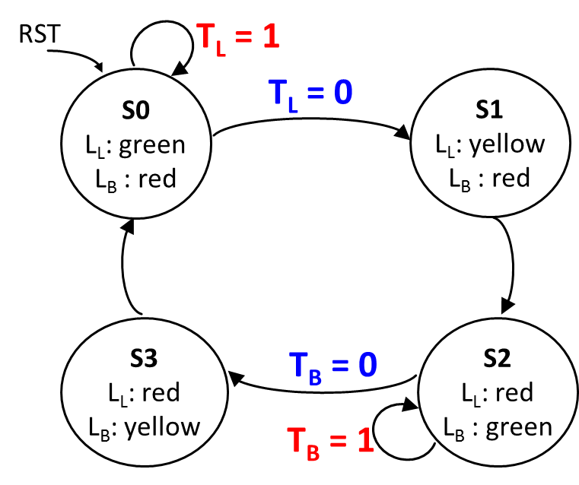
Step 2 : Next State Table
From STD, find the number of states
Number of bits / FFs required = ?_ to go through these states
State Assignment
Next State Table
State | S₁S₀
S0 | 00
S1 | 01
S2 | 10
S3 | 11
Current State | Inputs |  | Next State
S | T_{L} | T_{B} | S+
S0 | 0 | X | S1
S0 | 1 | X | S0
S1 | X | X | S2
S2 | X | 0 | S3
S2 | X | 1 | S2
S3 | X | X | S0

Slide 10
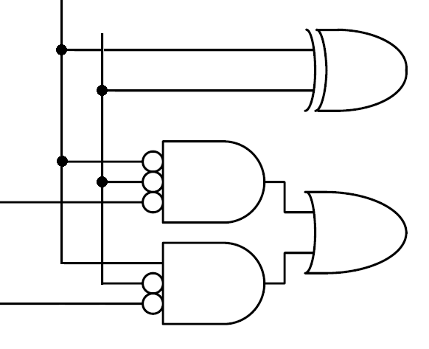
Step 2 : Next State Table
5. State Generator Circuit
Current State |  | Inputs |  | Next State
S₁ | S₀ | T_{L} | T_{B} | S₁+ | S₀+
0 | 0 | 0 | X | 0 | 1
0 | 0 | 1 | X | 0 | 0
0 | 1 | X | X | 1 | 0
1 | 0 | X | 0 | 1 | 1
1 | 0 | X | 1 | 1 | 0
1 | 1 | X | X | 0 | 0
S₁⁺
S₁
D Q
Next State
Current State
T_{L}
S₀⁺
S₀
D Q
T_{B}
CLK

Slide 11
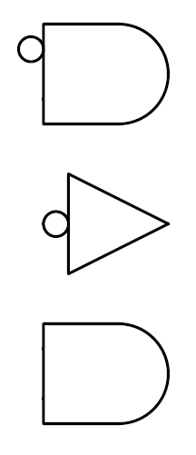
Step 3 : Output Logic
Output | L₁L₀
Green | 00
Yellow | 01
Red | 10
Output Truth Table
Current State |  | Outputs
S₁ | S₀ | L_{L1} | L_{L0} | L_{B1} | L_{B0}
0 | 0 | 0 | 0 | 1 | 0
0 | 1 | 0 | 1 | 1 | 0
1 | 0 | 1 | 0 | 0 | 0
1 | 1 | 1 | 0 | 0 | 1
L_{L1}
S₁⁺
S₁
L_{L0}
D Q
Next State
T_{L}
L_{B1}
S₀⁺
RST
S₀
D Q
Current State
T_{B}
CLK
L_{B0}
RST

Slide 12
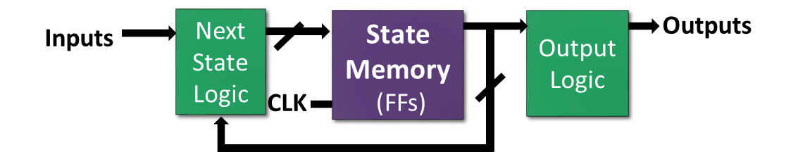
Verilog~! – Code Structure
Inputs
Next State Logic
State Memory
(FFs)
Output Logic
Outputs
CLK
Inputs
Next State Logic
State Memory
(FFs)
Output Logic
Outputs
CLK
Combinational
Circuit
Sequential
Circuit
Combinational
Circuit
always @ (*)
always @ (posedge clk)
assign y =

Slide 13
FSM in Verilog
module fsm(input clk, … , output … … );
reg __ state, nextstate;
parameter S0 = 2’b00;
parameter S1 = 2’b01;
always (*)
case (state)
S0 : nextstate = S1;
S1 : nextstate = S0;
endcase
always @ (posedge clk, posedge reset)
if (reset) state <= S0;
else state <= nextstate;
assign y = ( state == S0 );
endmodule
parameter is used to define constants within a module, improving code readability.
Next State Combinational Logic :
(*) code is triggered whenever any input changes ➔ combinational logic.
case represents next state table.
Sequential Logic : Use <= to infer flip-flops. Is this Sync or Async reset?
Output Logic : Use assign to infer combinational logic.
Equality Comparison : a == b evaluates to 1 if a equals b.

Slide 14
FSM Traffic Controller in Verilog
module traffic (input clk, reset, TL, TB, output [1:0] LL, LB);
reg [1:0] state, nextstate;
parameter S0 = 2’b00, S1 = 2’b01, S2 = 2’b10, S3 = 2’b11;
parameter green = 2’b00, yellow= 2’b01, red= 2’b10;
always @ (*) begin
case (state)
S0: nextstate = TL ? S0 : S1;
S1: nextstate = S2;
S2: nextstate = TB ? S2 : S3;
S3: nextstate = S0;
endcase
end
always@(posedge clk, posedge reset) begin
if (reset) state <= S0; state <= nextstate;
end
//What’s the diff between these //2 ways of coding output logic ?
assign LL
= {state[1], ~state[1] & state[0]};
assign LB = (state== S0 || state== S1) ? red : ( (state == S2) ? green : yellow );
endmodule

Slide 15
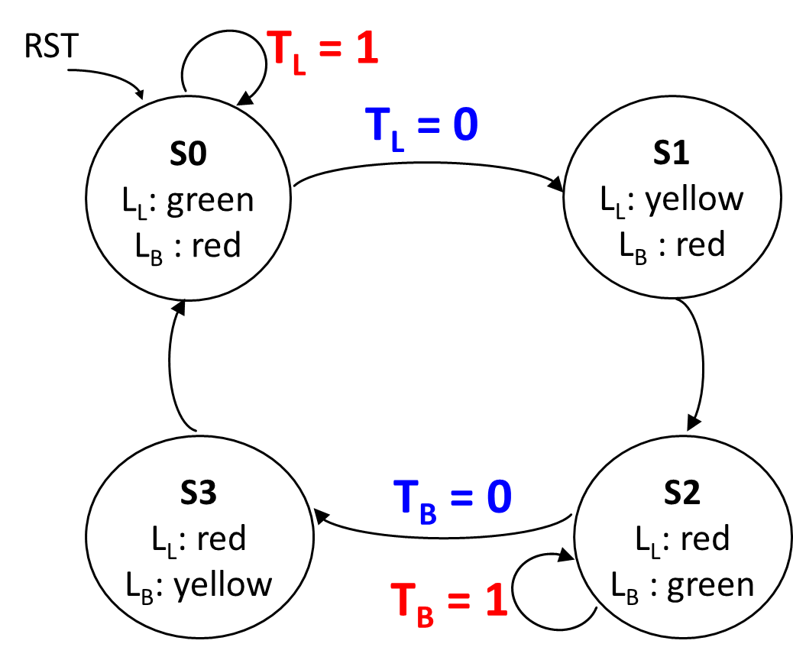
Timing Diagram
CLK
Reset
TL
TB
State
LL
LB

Slide 16
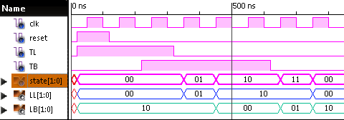
Traffic Controller
Check the waveforms in the timing diagram below…
Are they correct?
XX
S0
S1
S2
S3
green
yw
red
red
green
yw

